Slide 1
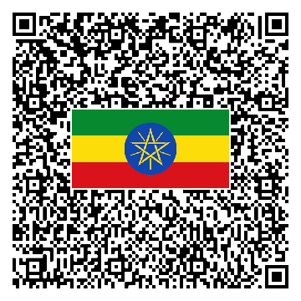


Adoption Of A National QR Code Standard
Technical Brief on the adoption of a National and Fully Interoperable QR Code Standard
September 2023

Slide 2
WHAT WE'LL COVER TODAY
Agenda for this Presentation and its Layout
As we aim to move towards a cash-lite society, the need for a unified, secure, and efficient payment system has never been greater. This standard serves as a cornerstone in achieving that vision
1. Introduction
2. Key Features of the Standard and alignment with best practices.
3. Current Use Cases covered by the Standard.
4. Next Steps for Payer and Payee FIs.
5. Conclusion

Slide 3
1. Introduction
Instant Payment System (IPS) QR Payment is a seamless and efficient digital payment solution designed to facilitate real-time transactions using QR codes. This system enhances financial inclusion by enabling individuals and businesses to make secure, instant, and cost-effective payments through mobile banking applications and other digital channels.
By leveraging QR technology, IPS QR Payment eliminates the need for physical cash, providing a more convenient and accessible alternative for both customers and merchants. With interoperability at its core, this payment method supports cross-bank transactions, fostering a more connected and efficient digital payment ecosystem.

Slide 4
2. KEY FEATURES OF THE STANDARD AND ALIGNMENT WITH BEST PRACTICES.
What are the Main Features of our proposed Standard
COVERS BOTH STATIC
& DYNAMIC QR CODES
BASED ON
EMVCo STANDARDS
ADVANCED SECURITY PROTOCOLS
Our standard supports both static and dynamic QR codes, catering to a variety of payment scenarios.
Our QR Code Standard is based on EMVCo standards, ensuring international compatibility and security.
Incorporates advanced security measures to protect against fraud and unauthorized transactions.
PROVIDES FULL INTEROPERABILITY
ADAPTED TO ETHIOPIAN CONTEXT
Designed to work seamlessly through integration with Real Time Payments System, ensuring a smooth transition for all stakeholders.
While aligned with global standards, the system is adapted to the unique needs and challenges of the Ethiopian market.

Slide 5
2. KEY FEATURES OF THE STANDARD AND ALIGNMENT WITH BEST PRACTICES.
Deep Dive into the Adaptations for Ethiopian Context
QR Payload Transposed for Readability
QR CODE
Payload Format Indicator: | 000201
Point of Initiation: | 010212
MAI1 Visa: | 02164000123456789012
MAI2 Mastercard: | 04165345123456789012
MAI3 Unionpay: | 15166345123456789012
MAI4 IPS ET: | 2876 0032581b314e257f41bfbbdc6384daa31d16
 | 0108CBETETAA
 | 02160000171234567890
Merchant Category Code: | 52045999
Currency: | 5303586
Country Code: | 5802ET
Merchant Name: | 5924TewodrosSpices&Grains
Merchant City: | 6007ADDISABABA
Addl. Data Template: | 6289 011723456785432123456
 | 021103240000000
 | 0324Tewodros Spices & Grains
 | 05131238765432123
 | 0712456789098765
CRC: | 63045376
00020101021202164000123456789012041653451234567890121516634512345678901228760032581b314e257f41bfbbdc6384daa31d160108CBETETAA021600001712345678905204599953035865802ET5924TewodrosSpices&Grains6010ADDISABABA62890117234567854321234560211032400000000324Tewodros Spices & Grains05131238765432123071245678909876563045376
Since IBAN’s aren’t rolled out across the board in Ethiopia,
We’ve designed the System to work such that it can take both
BIC + Account Number or just IBAN as Destination Account
Bill or Invoice Number
Phone Number
DECIPHERED TEXT
Store Name
Additional Reference Label that Merchants can use to Pass any value for Recon
Counter on Till ID
The CRC, as per the EMVCo QRCPS (QR Code Payment Specifications), provides a way to verify the integrity of the data contained within the QR code. If any part of the data is altered, the CRC value will change, indicating potential tampering or corruption.
The Standard will also support local language by allowing Merchant Store Labels and Reference Labels in Amharic.

Slide 6


3. CURRENT USE CASES COVERED BY THE STANDARD.
Summary of Use Cases that our Standard will Cover Right Now
Payer Persona
Payee Persona
Form factor / Location
Flow
Relevant Actors to go-live
Customer with a smart phone
Merchant with a smart phone
Static QR / In-store
Push payment by customer to Merchant
At least 1 Banks/EMIs/PSP who want to do as Payee
All Other banks as Payer
Customer with a smart phone
Merchant with a smart phone
Dynamic QR / In-store
Push payment by customer to Merchant
At least 1 Banks/EMIs/PSP who want to do as Payee
Other banks as Payer
Customer with a smart phone
Merchant is online website
Dynamic QR / Online
Push payment by customer to Merchant
PSP: to show Dynamic QR

Slide 7

3. CURRENT USE CASES COVERED BY THE STANDARD.
Merchant Presented Static QR Code - Push Payment by Customer Flow
Pay by IPS ET
Pay [Merchant XYZ]
Please pay Birr XX
XX
Birr
1
Merchant tells payment total
2
Customer opens payment app with QR code scanner
3
Customer scans merchant static (e.g., printed) QR
4
Customer inputs payment total
Please confirm you want to pay XX PKR to [Merchant XYZ]
You have received Birr XX
Please enter your PIN:
5
Customer authorizes payment
6
Customer receives confirmation
7
Merchant informed of receipt of funds¹
8
Merchant hands over merchandise
1. If PSP is the Merchant bank also, it will credit the account and deduct commission/fee. If PSP is not a bank, it will push a Payment (original amount minus commission) to Merchant’s bank.

Slide 8
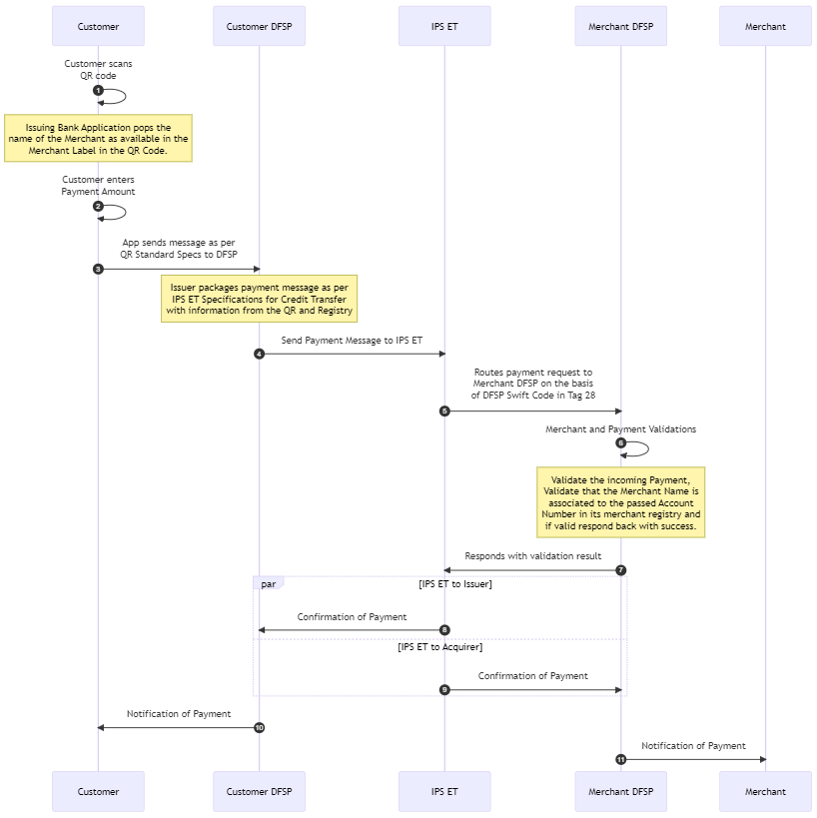
3. CURRENT USE CASES COVERED BY THE STANDARD.
Merchant Presented Static QR Code - Push Payment by Customer Flow
Customer scans the QR code. At this stage the Payer Bank Application displays the name of the Merchant, retrieved from the Merchant Label in the QR Code.
Customer enters the Payment Amount.
Customer's app sends a payment initiation message to the Payer(Customer DFSP). The Payer bank packages the payment message according to IPS ET Specifications, using information from the QR and Registry.
The Payer sends the Payment Message to IPS ET.
IPS ET routes the payment request to the Merchant DFSP (Payee) based on the DFSP Swift Code in Tag 28.
Acquirer (Merchant DFSP) performs Merchant and Payment Validations: It validates the incoming Payment. Validates that the Merchant Name is associated with the passed Account Number in its merchant registry.
The Payee responds with success if validations are successful.
IPS ET confirms the payment to the Payer and the Payee.
Payee (Merchant DFSP) receives the confirmation of payment from IPS ET.
Payer notifies the Customer about the successful payment.
Payee notifies the Merchant about the successful payment.

Slide 9
3. CURRENT USE CASES COVERED BY THE STANDARD.
Merchant Presented Dynamic QR Code - Push Payment by Customer Flow
Pay [Merchant XYZ]
Pay by IPS ET
Your total is Birr XX
XX
Birr
Pay by IPS ET
1
Merchant tells payment total
2
Merchant opens his payment app and enters amount to create QR
3
Merchant Displays generated QR on POS or Tablet or Screen
4
Customer scans merchant dynamic QR from POS or Screen
Please confirm you want to pay XX PKR to [Merchant XYZ]
You have received Birr XX
Please enter your PIN:
5
Customer authorizes payment
6
Customer receives confirmation
7
Merchant informed of receipt of funds
8
Merchant hands over merchandise

Slide 10
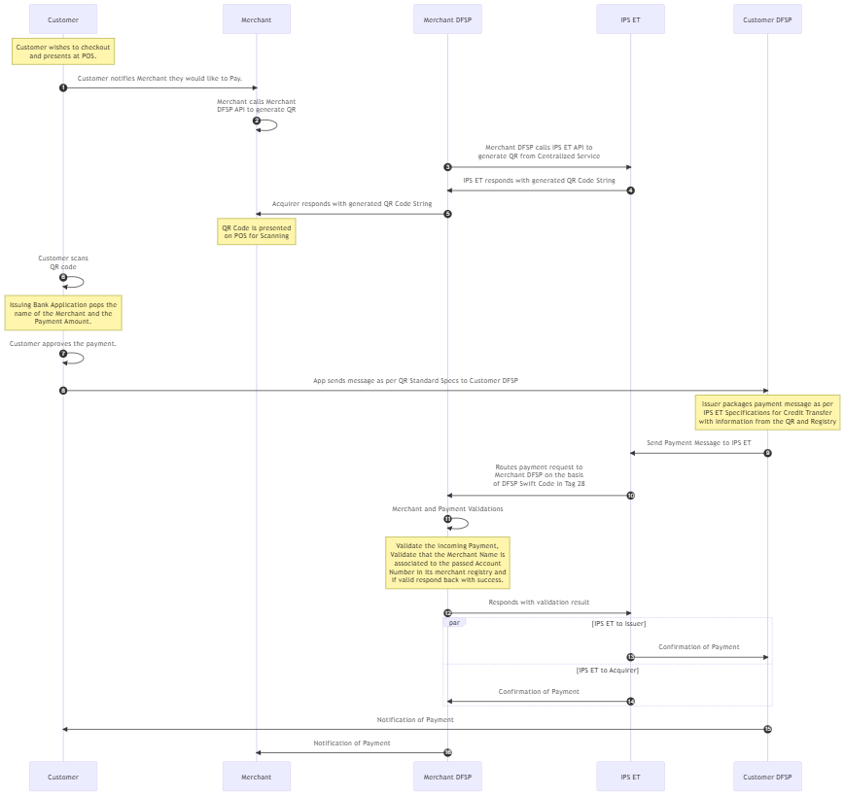
3. CURRENT USE CASES COVERED BY THE STANDARD.
Merchant Presented Dynamic QR Code - Push Payment by Customer Flow
The customer presents at the Point of Sale (POS) for checkout, the customer notifies the Merchant about their intention to pay.
The merchant calls the Merchant DFSP API to generate a QR code by providing it all relevant information necessary to generate the QR Code.
Merchant DFSP (Payee) calls the IPS ET API to generate a QR code through the Centralized Service.
IPS ET responds to the Payee with the generated QR code string.
Acquirer (Merchant DFSP) responds to the Merchant with the generated QR code string and the QR code is displayed on the POS for scanning.
Customer scans the QR code. At this stage the Payer Bank Application displays the name of the Merchant, retrieved from the Merchant Label in the QR Code.
Customer enters the Payment Amount.
Customer's app sends a payment initiation message to the payer (Customer DFSP). The payer packages the payment message according to IPS ET Specifications, using information from the QR and Registry.
The payer sends the Payment Message to IPS ET.
IPS ET routes the payment request to the Merchant DFSP (Payee) based on the DFSP Swift Code in Tag 28.

Slide 11
3. CURRENT USE CASES COVERED BY THE STANDARD.
Merchant Presented Dynamic QR Code - Push Payment by Customer Flow
Payee (Merchant DFSP) performs Merchant and Payment Validations: It validates the incoming Payment. Validates that the Merchant Name is associated with the passed Account Number in its merchant registry.
The Payee responds with success if validations are successful.
IPS ET confirms the payment to the Payer and the payee.
Payee (Merchant DFSP) receives the confirmation of payment from IPS ET.
Payer notifies the Customer about the successful payment.
Payee notifies the Merchant about the successful payment.

Slide 12
4. NEXT STEPS FOR Payees AND Payers.
What will the Different Kinds of Stakeholders need to do at their end to Adopt the Standard
Type of flow
PSP
Customer bank
Merchant Bank
1
Customer initiated push payment to merchant
Onboard and manage merchant
Provide merchant with front end channel to create payment order
For QR payment, generate the QR
Provide merchant with status of payment
Manage MDR/Merchant fee
Provide customer with channel to initiate payment
Provide customer confirmation that payment has been done
Receive payment and notify merchant
Provide merchant with enough information on Bank statement to match funds received with invoice/bill

Slide 13
5. Conclusion
IPS QR Payment is a transformative innovation in the digital payments landscape, offering a fast, secure, and user-friendly transaction experience.
Its ability to streamline payments, enhance financial inclusion, and support interoperability among financial institutions makes it a key driver in the evolution of cashless economies.
As adoption grows, IPS QR Payment will continue to redefine the way businesses and consumers transact, ensuring a more efficient and digitally connected financial ecosystem.

